Slide 1
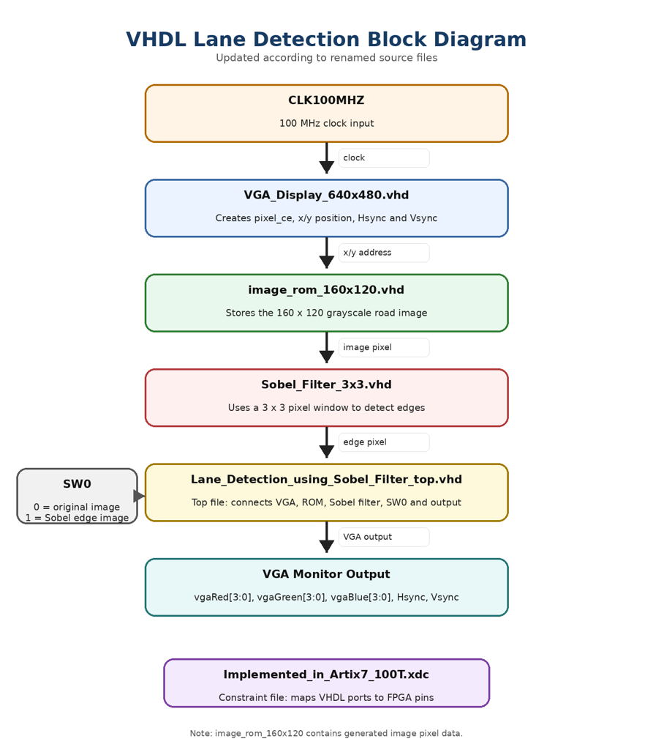
Project Concept
VGA_Display_640x480 creates the VGA timing signals and gives the current x/y pixel position.
The x/y position is converted to a 160 x 120 image address and sent to image_rom_160x120.
image_rom_160x120 outputs one grayscale road-image pixel.
Sobel_Filter_3x3 builds a 3 x 3 pixel window and calculates the Sobel edge strength.
Lane_Detection_using_Sobel_Filter_top selects original image or Sobel output using SW0.
The selected grayscale pixel is sent to the VGA RGB outputs, together with Hsync and Vsync.
Lane Detection using Sobel Filter | 1

Slide 2
Implementation
Prepared for Artix-7 / Nexys A7 hardware
VHDL Files
VHDL file | Purpose | Beginner explanation
Lane_Detection_using_Sobel_Filter_top.vhd | Top-level VHDL file | Connects all other modules and board I/O.
VGA_Display_640x480.vhd | VGA timing generator | Creates x/y position, pixel_ce, visible area, Hsync and Vsync.
image_rom_160x120.vhd | Image ROM | Stores the grayscale road image as pixel values.
Sobel_Filter_3x3.vhd | Sobel filter module | Detects image edges using a 3 x 3 pixel window.
Implemented_in_Artix7_100T.xdc | Constraints file | Maps VHDL ports to real FPGA board pins.
Display Modes
SW0 value | VGA output
0 | Original road image
1 | Sobel edge-detection output
Inputs and Outputs
Signal | Direction | Purpose
CLK100MHZ | Input | 100 MHz clock from the Nexys A7 board
SW0 | Input | Selects original image or Sobel edge output
vgaRed[3:0] | Output | 4-bit VGA red signal
vgaGreen[3:0] | Output | 4-bit VGA green signal
vgaBlue[3:0] | Output | 4-bit VGA blue signal
Hsync | Output | VGA horizontal synchronization signal
Vsync | Output | VGA vertical synchronization signal
Lane Detection using Sobel Filter | 2

Slide 3
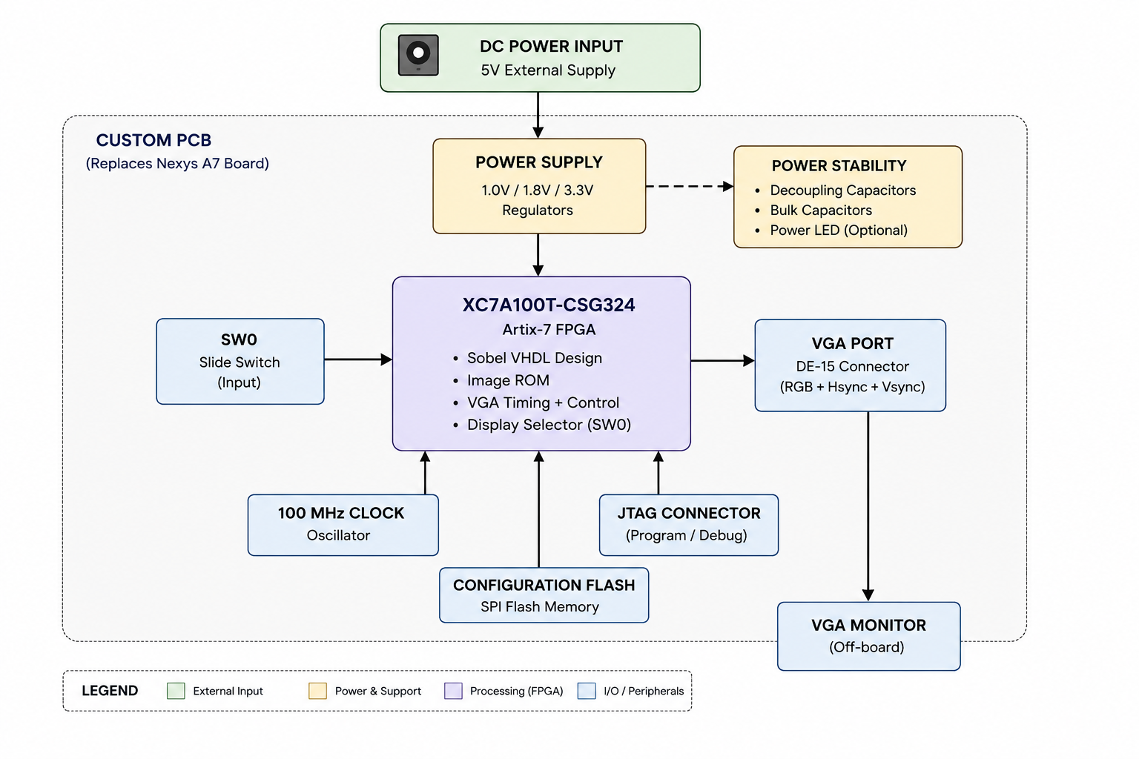
FPGA-to-PCB Concept Result
Custom PCB concept replacing the Nexys A7 board hardware
Lane Detection using Sobel Filter | 3

